Slide 1

Air Travel Safety
Kimberly Adams
DSC 640, Fall 2023

Slide 2
In our daily commute, we often run across at least one vehicle accident…
And this is just the fatal accidents…
many more accidents are not included
SOURCE: NHTSA Summary of Motor Vehicle Traffic Crashes (https://www-fars.nhtsa.dot.gov/Main/index.aspx)

Slide 3
and yet these car accidents rarely make more than local headlines if even that… just a passing note of a slowdown or to take an alternate route in the radio traffic report. Essentially they are so common, they aren’t newsworthy.

Slide 4
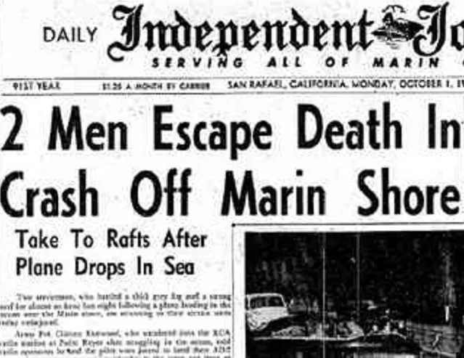
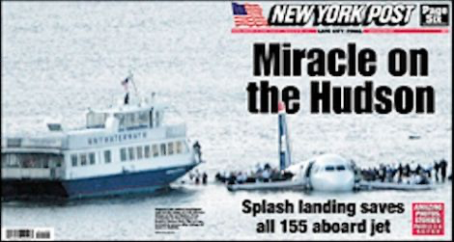



But when anything happens on an airplane, it often makes national, sometimes international news:

Slide 5
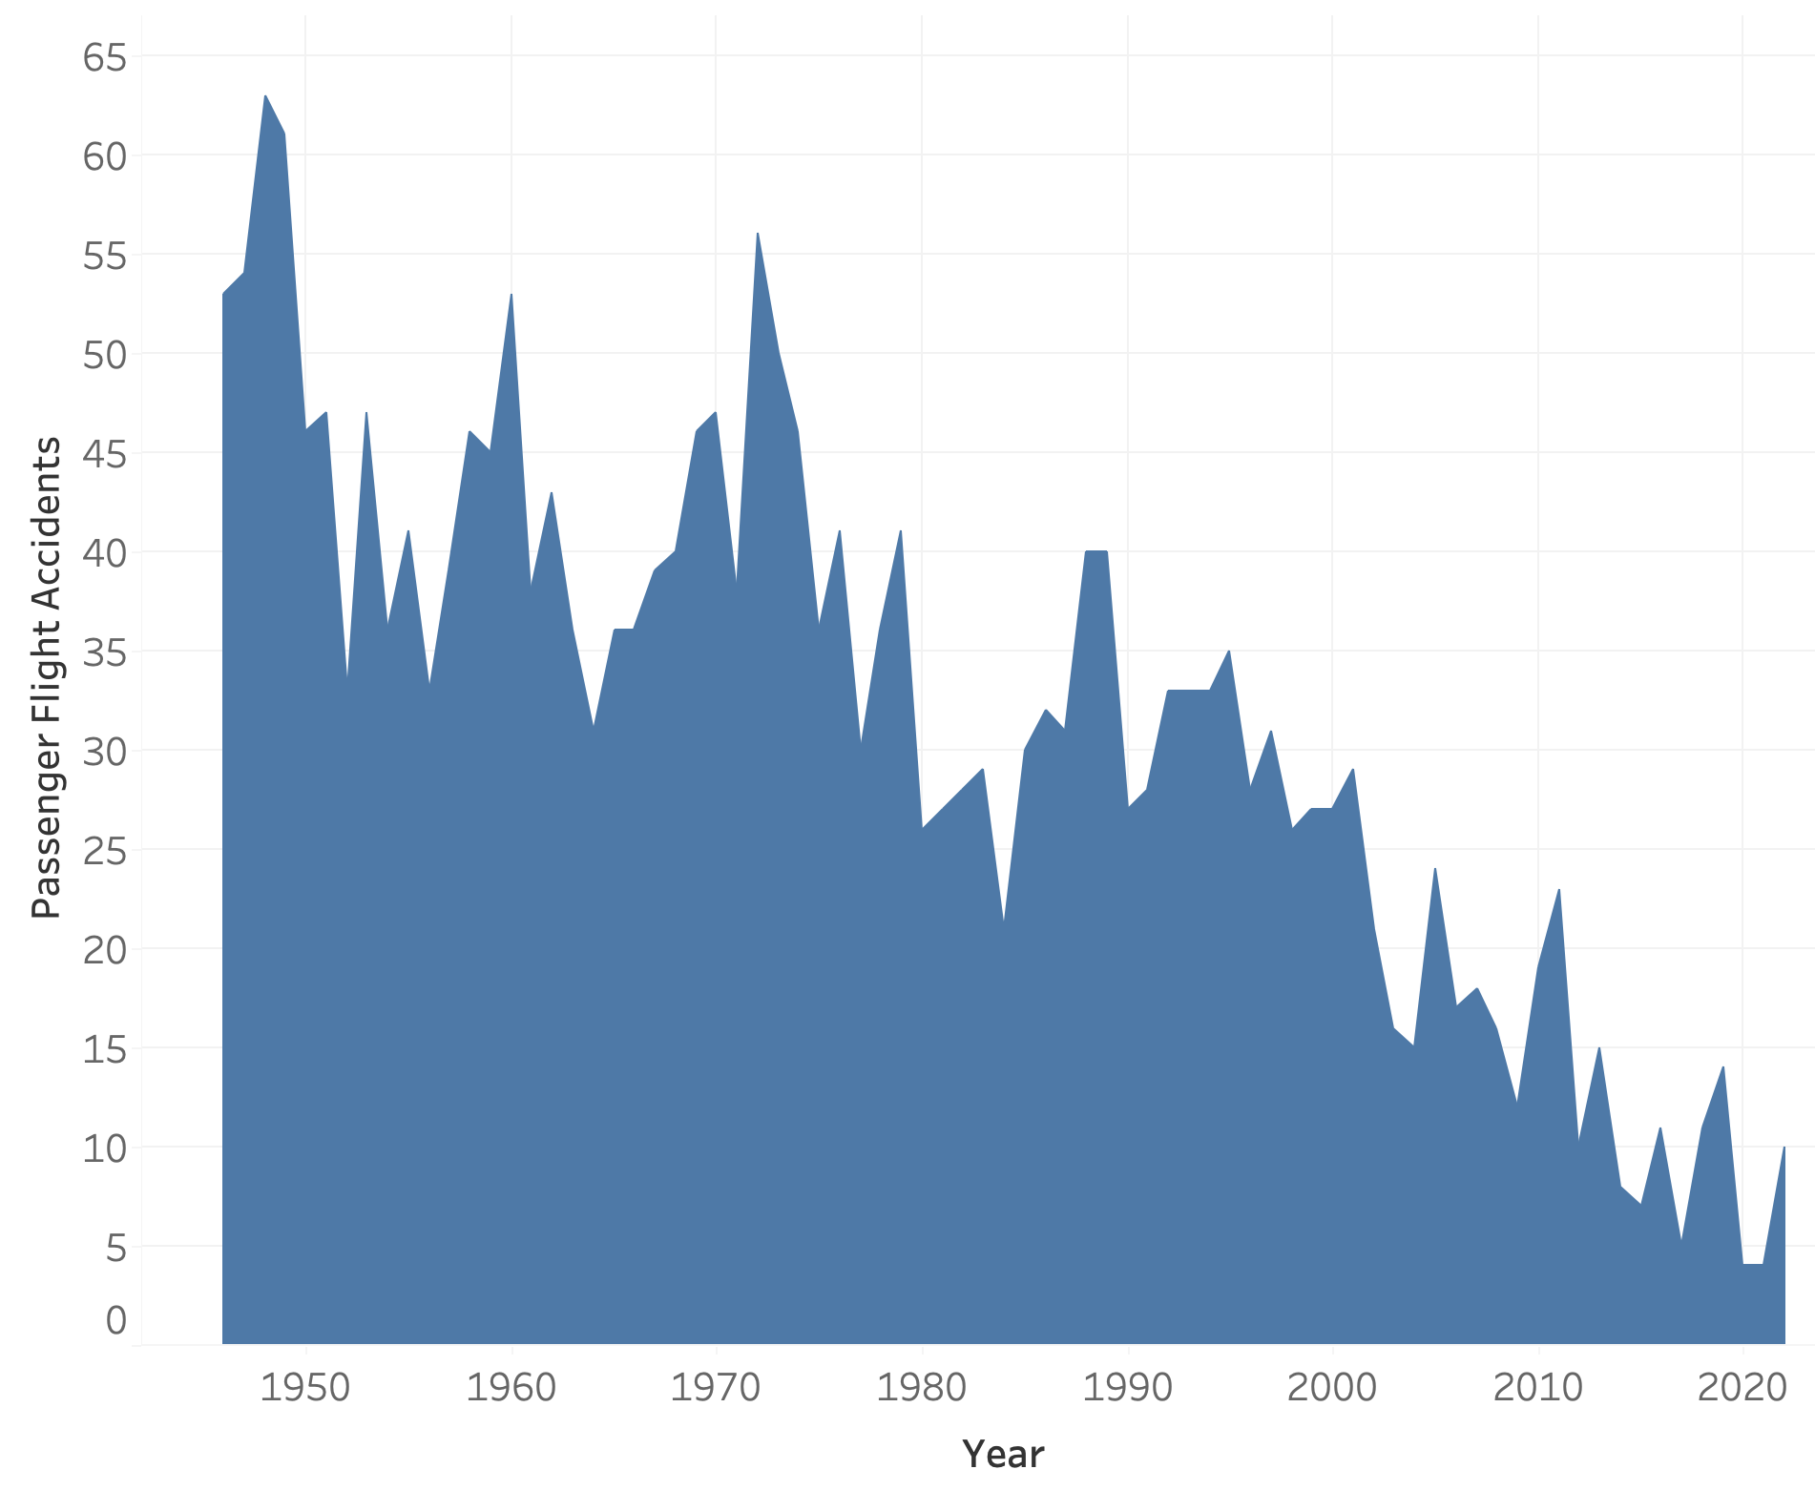
Despite the headlines, air travel is safer now than ever before:
~65 accidents
The number of accidents has steadily dropped by 83%
~10 accidents
SOURCE: Accidents numbers from Accidents and Fatalities Per Year (https://docs.google.com/spreadsheets/d/1SDp7p1y6m7N5xD5_fpOkYOrJvd68V7iy6etXy2cetb8/edit#gid=1448957446)

Slide 6
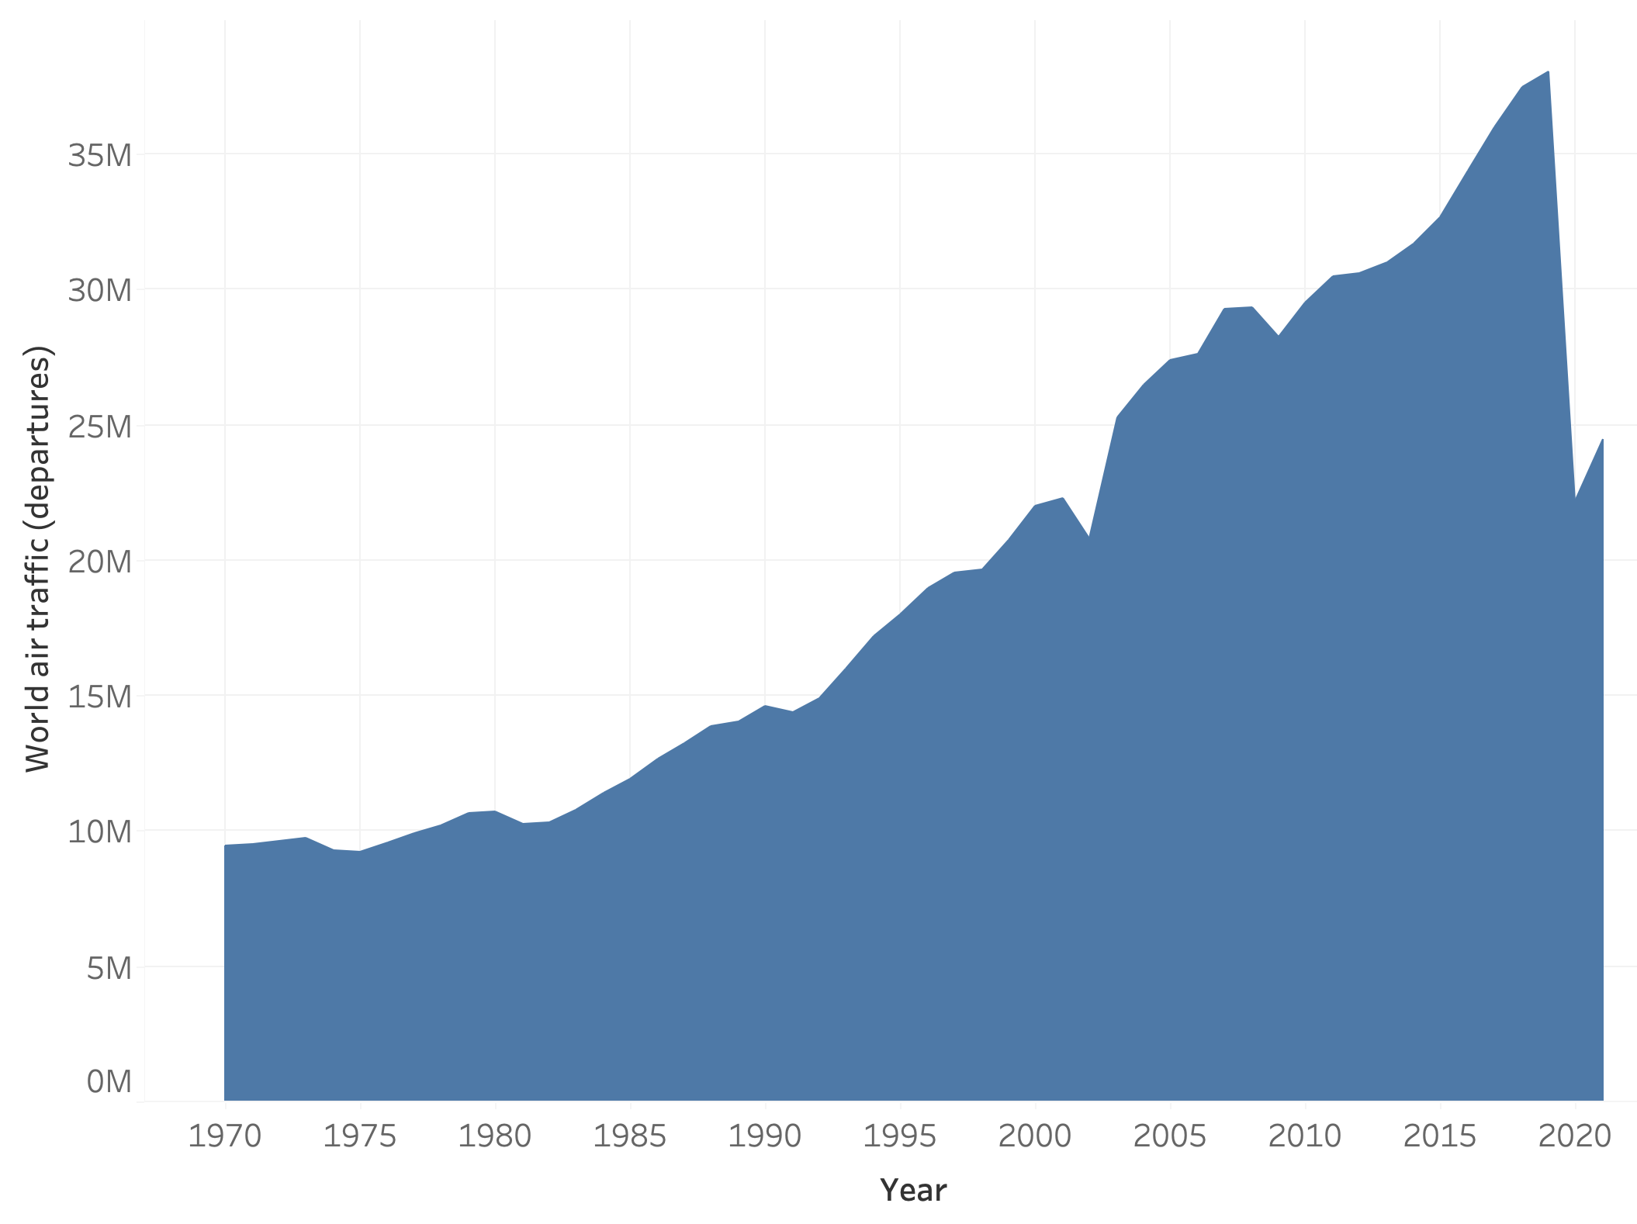
This is even with the number of flights almost 400% higher what they were in the 1970s
~40 million departures
Note the drop due to COVID, but also the quick bounce back after
~10 million departures
SOURCE: Accidents numbers from Accidents and Fatalities Per Year (https://docs.google.com/spreadsheets/d/1SDp7p1y6m7N5xD5_fpOkYOrJvd68V7iy6etXy2cetb8/edit#gid=1448957446)

Slide 7
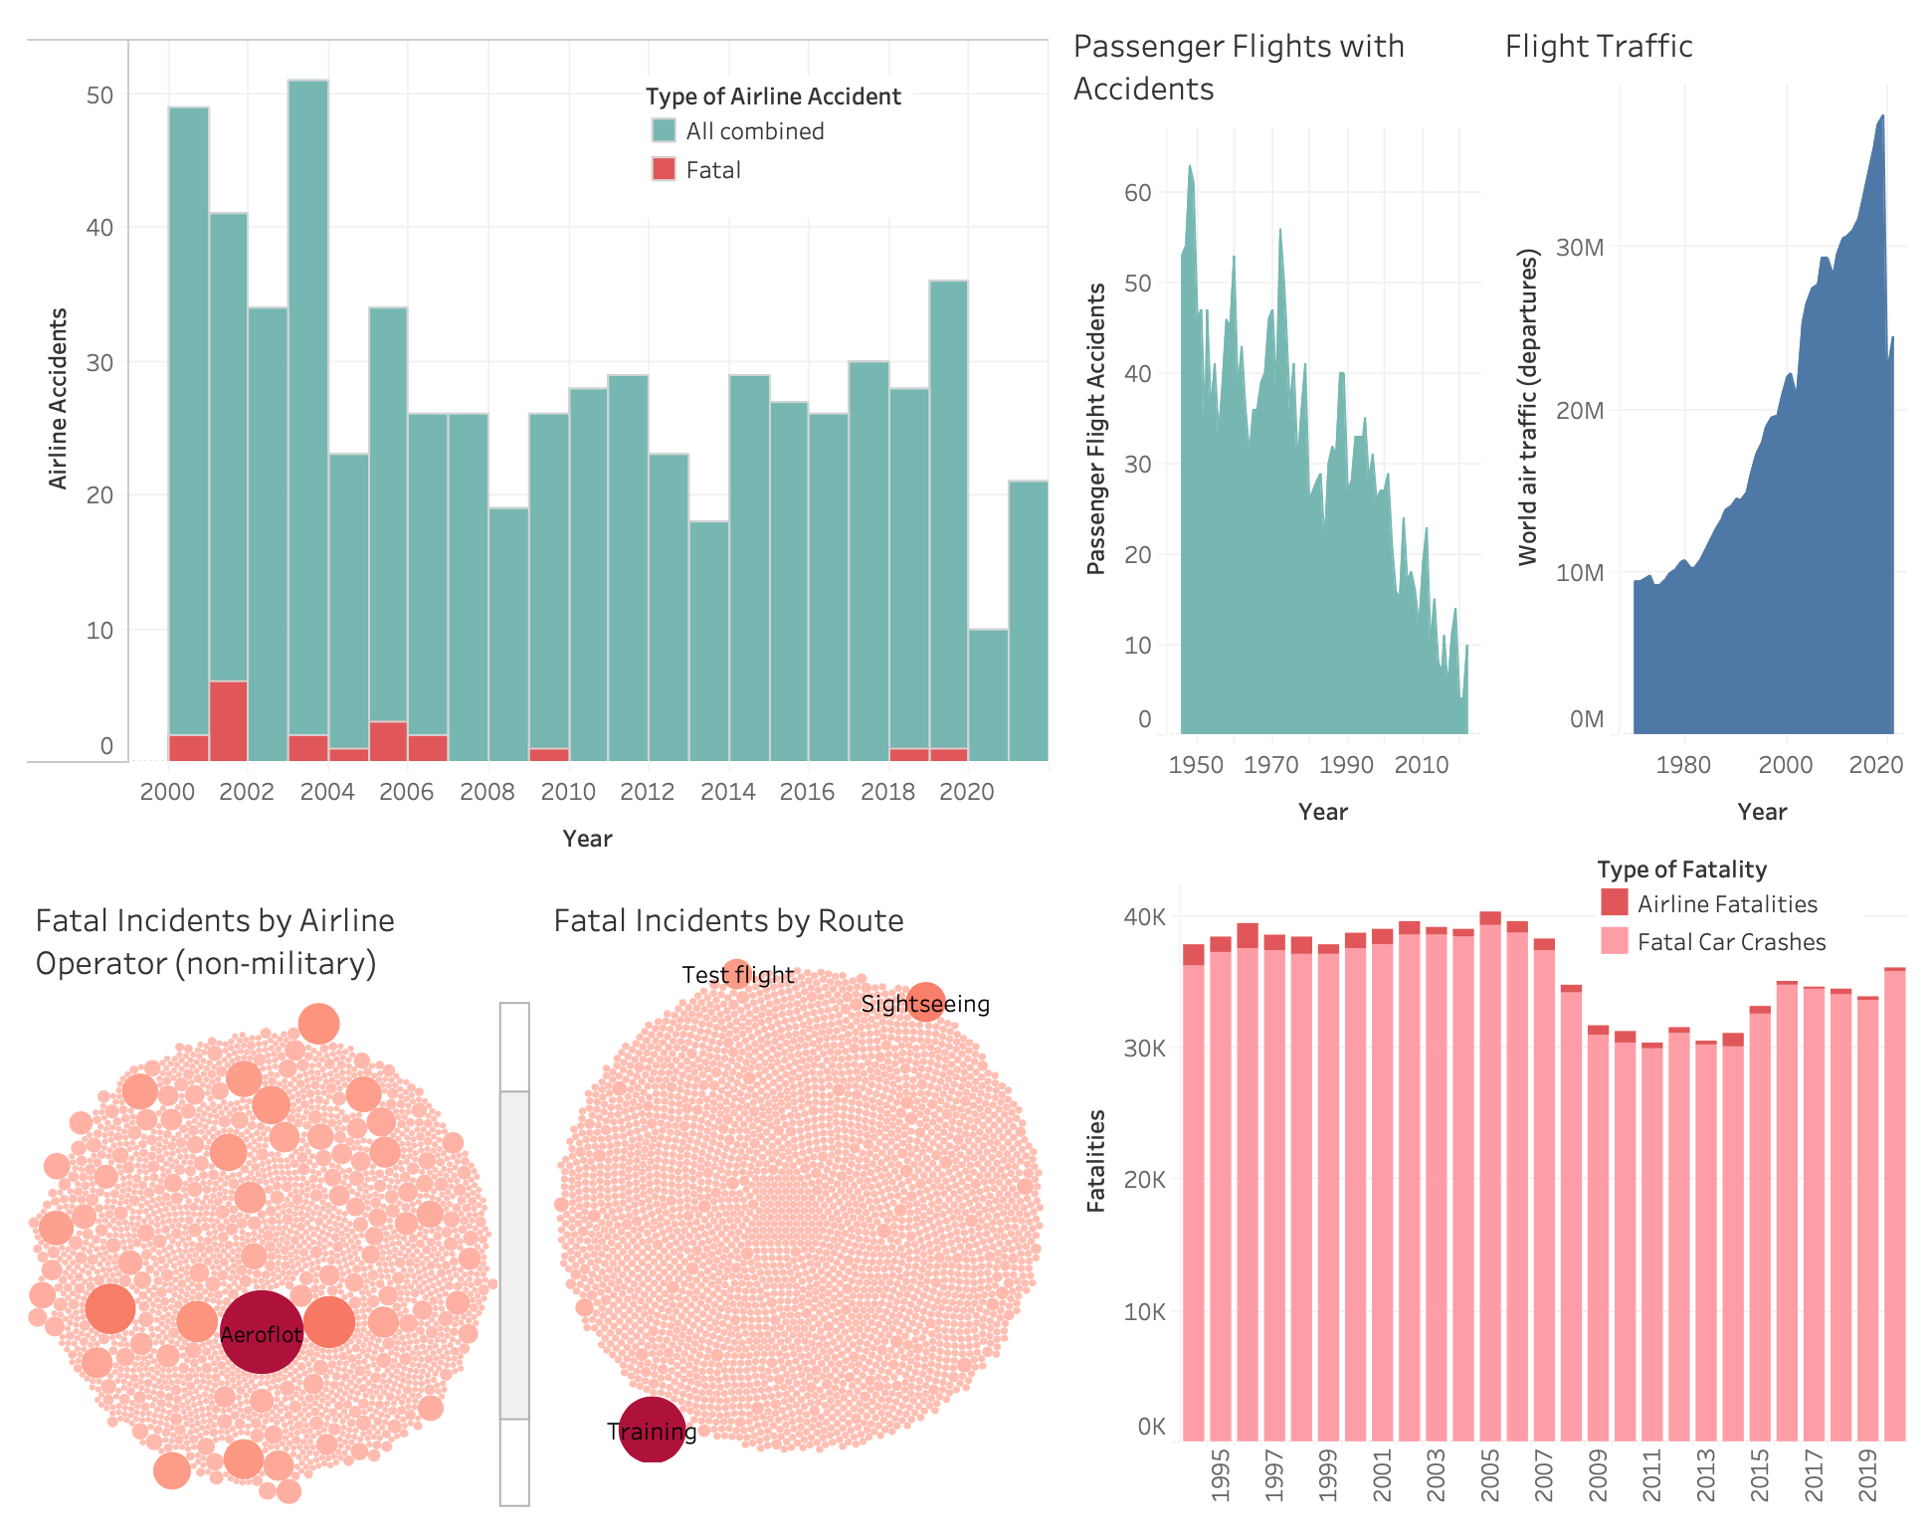
Looking closer at the airline accidents:
Less than 20% of airline accidents result in fatalities
This number is decreasing over time
SOURCE: Safety Record of U.S. Air Carriers (https://www.airlines.org/dataset/safety-record-of-u-s-air-carriers/)

Slide 8
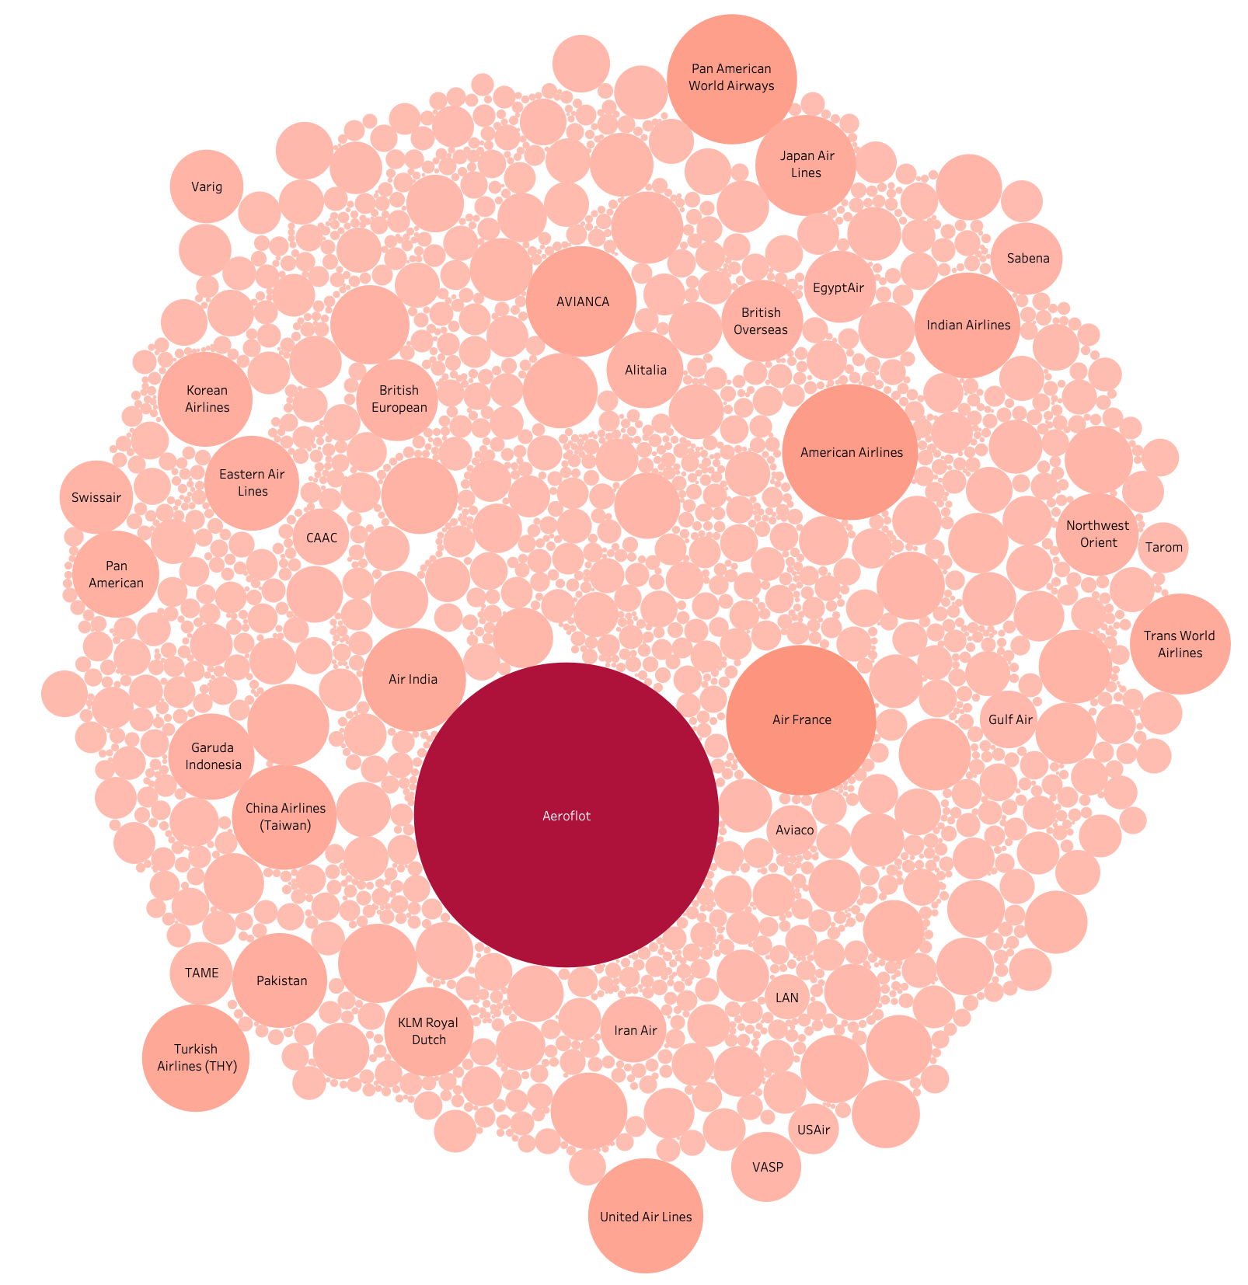
Accidents by Operator:
NOTE: Military-related operators removed to focus on commercial flights
Typically larger and older airline operators have larger counts
Higher passenger volume each year = greater opportunity for incidents
Russian airline Aeroflot has much higher fatalities compared to the others
One of the oldest airlines still operating
SOURCE: Airplane Crashes 1908-2009 (https://data.world/hhaveliw/airplane-crashes-1908-2009)

Slide 9
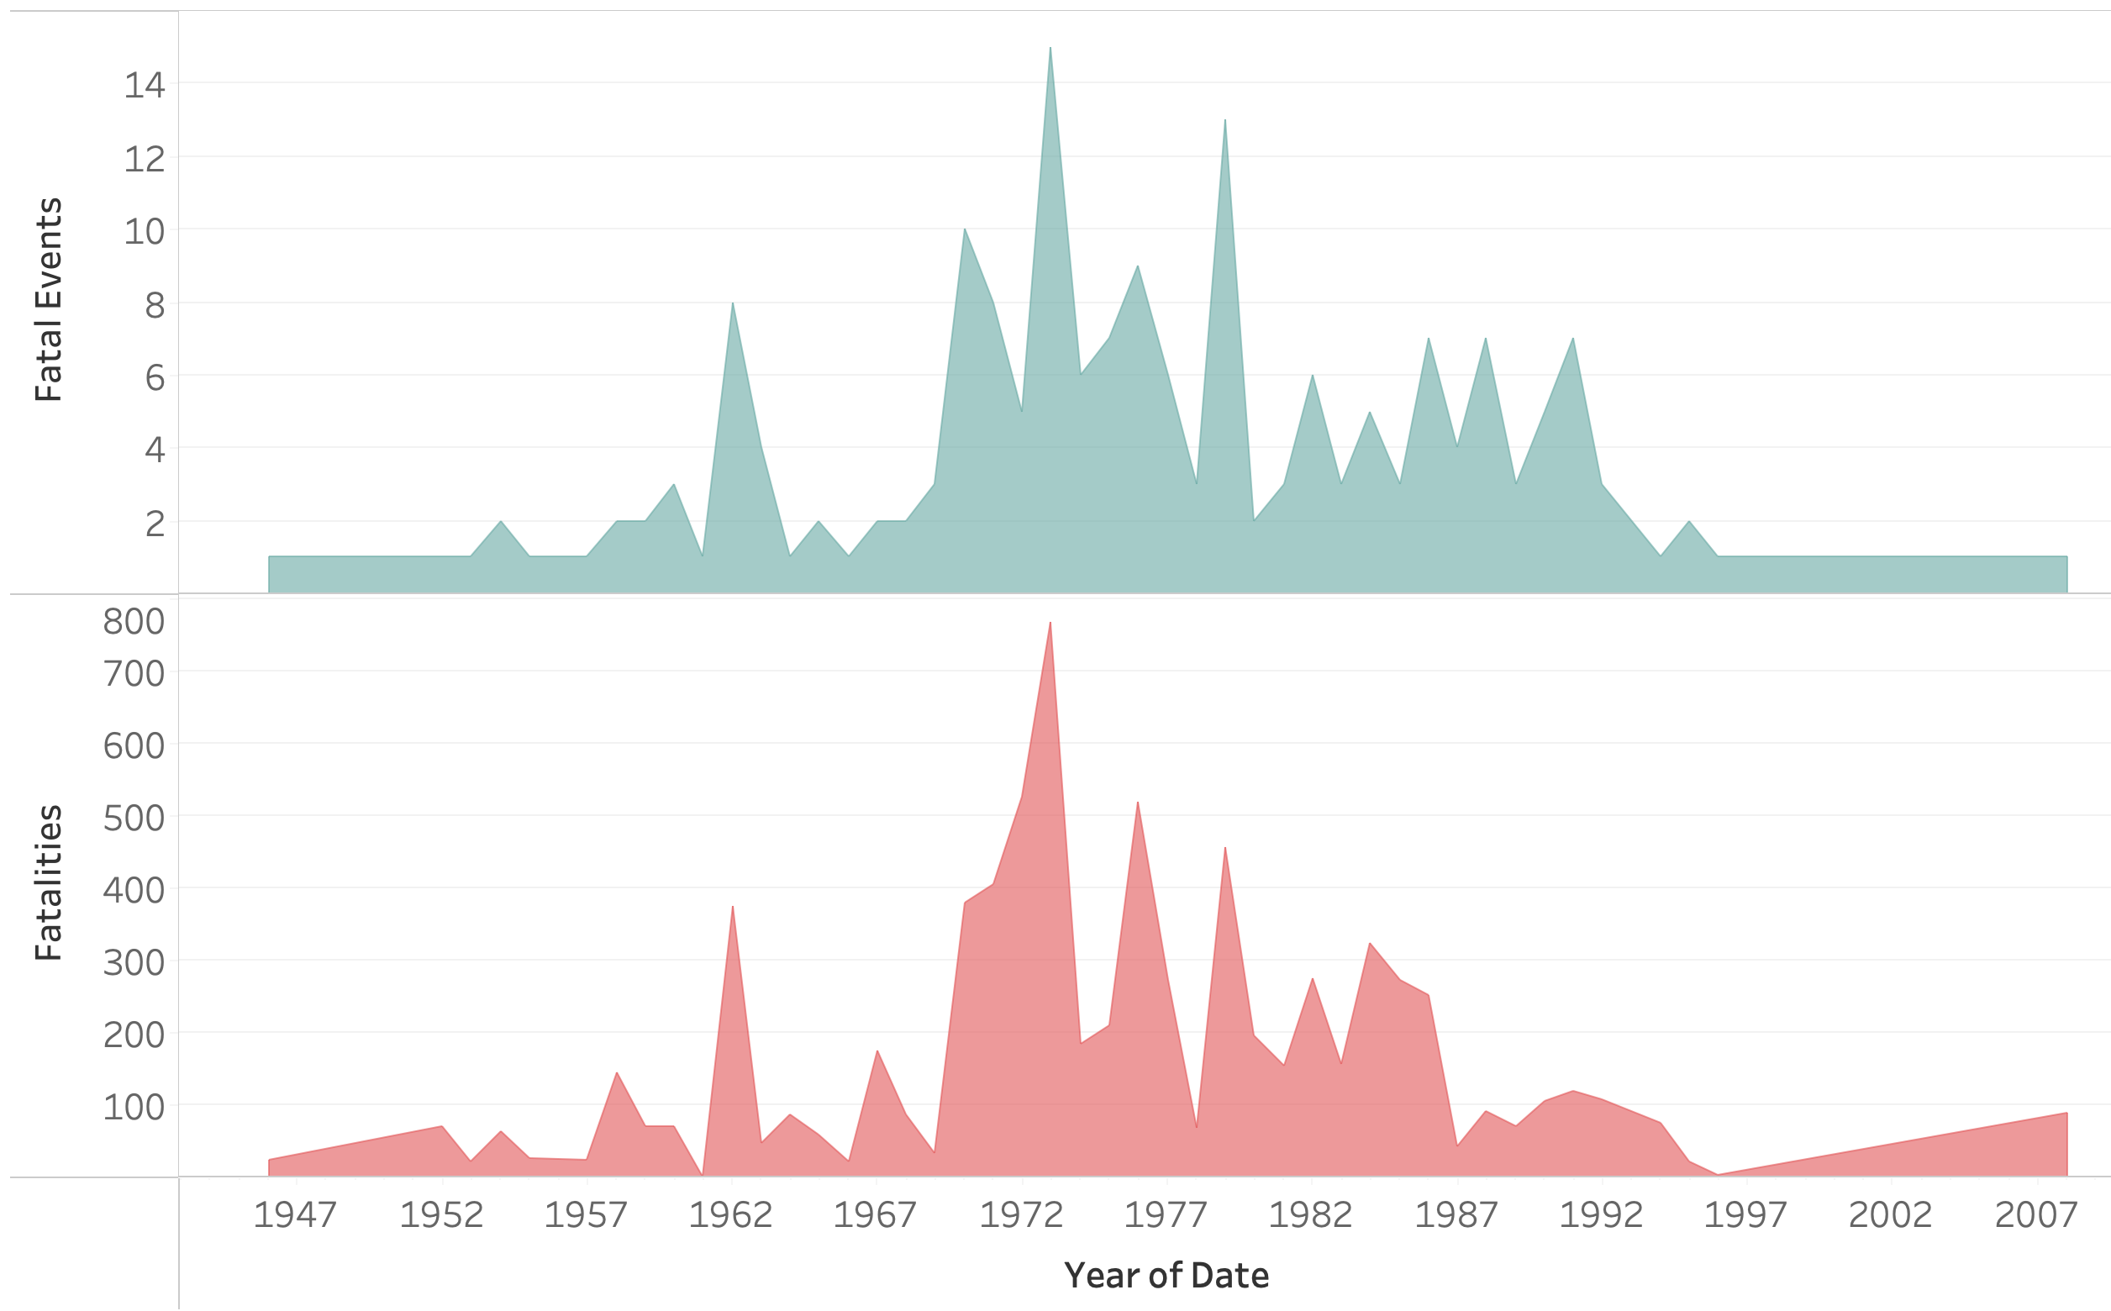
Aeroflot: Mini Case Study
Aeroflot may have had some rough years from 1960-1990, but has reduced events and fatalities in recent years.
Perhaps there was some relaxation of standards during this time period?
As planes get larger, each event might impact more passengers…
but as planes get new safety features, less passengers are likely to get hurt or as badly hurt
SOURCE: Accidents numbers from Accidents and Fatalities Per Year (https://docs.google.com/spreadsheets/d/1SDp7p1y6m7N5xD5_fpOkYOrJvd68V7iy6etXy2cetb8/edit#gid=1448957446)

Slide 10
Accidents By Route:
Most fatal incidents have occurred during training, test fights, or sight seeing excursions.
Less skill level and/or preparation prior to these flights?
Usually involve a small number of people
Almost all other routes reviewed had less than 2 incidents each
SOURCE: Airplane Crashes 1908-2009 (https://data.world/hhaveliw/airplane-crashes-1908-2009)

Slide 11
Comparing the fatalities between airplanes and cars just here in the US:
Fatal car crashes are much greater in number than airline fatalities
Even assuming just a single fatality in each car crash event; often there are multiple
Even though airline fatalities are decreasing, fatal car crashes have not seen much of a decrease in recent years
SOURCE: NHTSA Summary of Motor Vehicle Traffic Crashes (https://www-fars.nhtsa.dot.gov/Main/index.aspx) and Accidents numbers from Accidents and Fatalities Per Year (https://docs.google.com/spreadsheets/d/1SDp7p1y6m7N5xD5_fpOkYOrJvd68V7iy6etXy2cetb8/edit#gid=1448957446)

Slide 12
Despite this, cars are still the most popular form of transportation, at least for shorter trips
Flexibility
Familiarity of personal transportation
Use at destination
Not having to share space with strangers
Often cheaper
Reduces many travel hassles
But for longer trips, a greater proportion are made by air:
More efficient use of time
Costs balance out
Some locations not accessible by other means
Safer
SOURCE: U.S. Department of Transportation, Research and Innovative Technology Administration, Bureau of Transportation Statistics, Federal Highway Administration, National Household Travel Survey, long distance file, 2001, (Washington, DC)

